Slide 1
Office of the Vice President for Research Human Subjects Protection Program
Does my Project Needs IRB Review?
February, 2024

Slide 2
Does my Project Needs IRB Review?
Objectives
Common Rule:
To determine if a project is a research project.
To determine if a research project involves human subjects.
HIPAA Rule:
To determine whether a project falls within the definition of treatment, payment or health care operations.
To determine whether a project involves the use of Protected Health Information.

Slide 3
Human Subjects Research Determination Form
Prior to submitting an application for IRB review you should have determined that your project is a research project involving human subjects.
COMMON RULE
FDA Regulations
The Human Subject Research Determination Form.doc is made available so that individuals can self-determine whether IRB review is necessary.
The form is to be used for an activity/project that does not involve the use of a drug, device or biologic and that is not intended to be submitted to the FDA in support of a marketing application.
If an investigator would like to use a determination form for a project that does involve the use of a drug, device or biologic, contact the IRB irb@uchc.edu to obtain another version of the HSDF that also incorporates FDA definitions.

Slide 4
Human Subjects Research Determination Form Parts
Common Rule:
Part I - Research Determination
Part II - Human Subject Determination
HIPAA Rule:
Part III - HIPAA Compliance
Additional Details to Provide to the IRB:
Part IV – Summary and description of the project

Slide 5
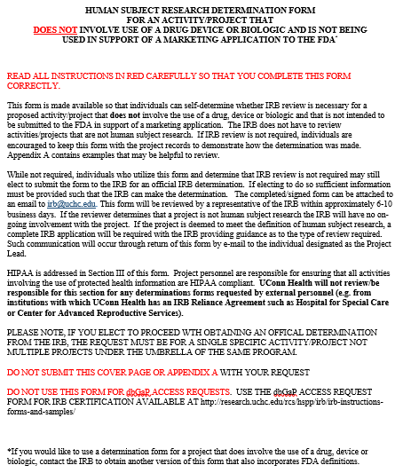
Human Subjects Research Determination Form
The IRB does not have to review activities/projects that are not human subject research.
If IRB review is not required, individuals are encouraged to keep this form with the project records to demonstrate how the determination was made.
If the HSDF is submitted, the request must be for a single specific activity/project not multiple projects under the umbrella of the same program.
Do not submit this cover page or appendix A with your request

Slide 6
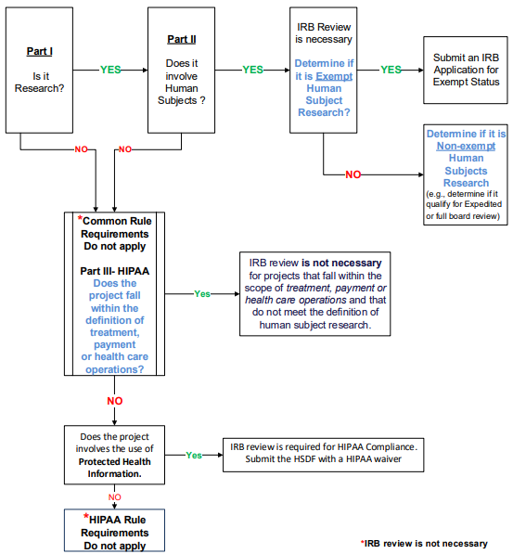
Human Subjects Research Determination Form
This presentation will walk you thru the steps of understanding the questions found in Part I, Part II, and Part III of this diagram, also found in the Human Subject Research Determination Form (HSDF).

Slide 7
Human Subjects Research Determination Questions
Common Rule:
Part I - Research Determination
Part II - Human Subject Determination

Slide 8
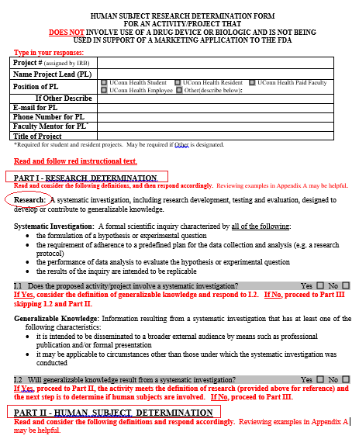
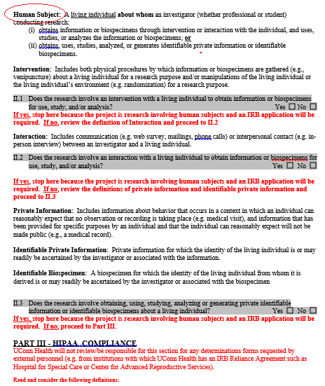
Page 2
Page 3

Slide 9
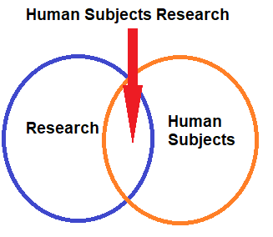
Human Subjects Research Determination
To determine whether a project is a human subject research project, the following questions should be addressed in chronologic order:
Does the activity involve research?
Does the research activity involve human subjects?
If the answers to each of these two questions is yes, then the project is considered a human subject research project and IRB review is required.

Slide 10
WHAT IS HUMAN SUBJECTS RESEARCH?
First Question-
Is the Activity Research?
Not all research is considered to be research under the Common Rule.
The Common Rule defines research as:
“a systematic investigation, including research development, testing, and evaluation, designed to develop or contribute to generalizable knowledge.”
Notes:
Generalizable Knowledge: Information resulting from a systematic investigation that has at least one of the following characteristics:
it is intended to be disseminated to a broader external audience by means such as professional publication and/or formal presentation
it may be applicable to circumstances other than those under which the systematic investigation was conducted
Research: A systematic investigation, including research development, testing and evaluation, designed to develop or contribute to generalizable knowledge.

Slide 11
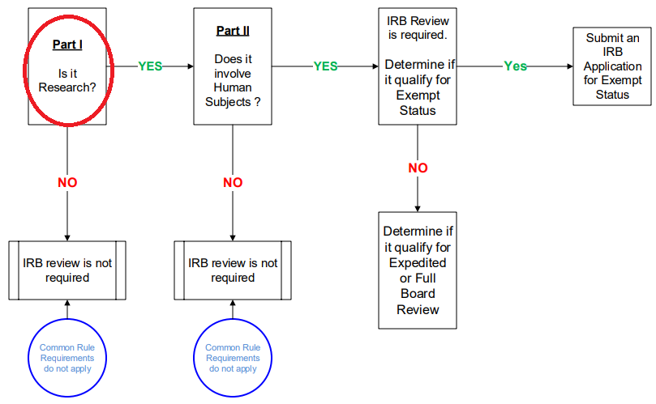
Definitions – What is Research?
Systematic Investigation: A formal scientific inquiry characterized by all of the following:
the formulation of a hypothesis or experimental question
the requirement of adherence to a predefined plan for the data collection and analysis (e.g. a research protocol)
the performance of data analysis to evaluate the hypothesis or experimental question
the results of the inquiry are intended to be replicable
Generalizable Knowledge: Information resulting from a systematic investigation that has at least one of the following characteristics:
it is intended to be disseminated to a broader external audience by means such as professional publication and/or formal presentation
or
it may be applicable to circumstances other than those under which the systematic investigation was conducted
I.1-Does the proposed activity/project involve a systematic investigation?
If Yes, consider the definition of generalizable knowledge and respond to I.2.
If No, proceed to Part III skipping 1.2 and Part II.
I.2-Will generalizable knowledge result from a systematic investigation?
If Yes, proceed to Part II, the next step is to determine if human subjects are involved.
If No, proceed to Part III.
Notes:
Will generalizable knowledge result from a systematic investigation?
If Yes, proceed to Part II, the activity meets the definition of research (provided above for reference) and the next step is to determine if human subjects are involved. If No, proceed to Part III.

Slide 12
WHAT IS A HUMAN SUBJECT?
Second Question-
Does the Research Involve Human Subjects?
The Common Rule defines human subject as:
“a living individual about whom an investigator (whether professional or student) conducting research:
II.1-2- Obtains information or biospecimens through intervention or interaction with the individual, and, uses studies, or analyzes the information or biospecimens;
or
II.3 - Obtains, uses, studies, analyzes, or generates
identifiable private information or identifiable biospecimens.”
Notes:
Human Subject: A living individual about whom an investigator (whether professional or student) conducting research:
(i) obtains information or biospecimens through intervention or interaction with the individual, and uses, studies, or analyzes the information or biospecimens; or
(ii) obtains, uses, studies, analyzed, or generates identifiable private information or identifiable biospecimens.

Slide 13
Second Question- Does the Research Involve Human Subjects?
The Common Rule defines human subject as:
a living individual about whom an investigator conducting research:
Obtains information or biospecimens through intervention with the individual, and, uses studies, or analyzes the information or biospecimens
Intervention: Includes both physical procedures by which information or biospecimens are gathered (e.g., venipuncture) about a living individual for a research purpose and/or manipulations of the living individual or the living individual’s environment (e.g. randomization) for a research purpose.
II.1- Does the research involve an intervention with a living individual to obtain information or biospecimens for use, study, and/or analysis?
If yes, stop here because the project is research involving human subjects and an IRB application will be required.
If no, review the definition of Interaction and proceed to II.2
Obtains information or biospecimens through an interaction with the individual, and, uses studies, or analyzes the information or biospecimens
Interaction: Includes communication (e.g. web survey, mailings, phone calls) or interpersonal contact (e.g. in-person interview) between an investigator and a living individual.
II.2- Does the research involve an interaction with a living individual to obtain information or biospecimens for use, study, and/or analysis?
If yes, stop here because the project is research involving human subjects and an IRB application will be required.
If no, review the definitions of private information and identifiable private information and proceed to II.3

Slide 14
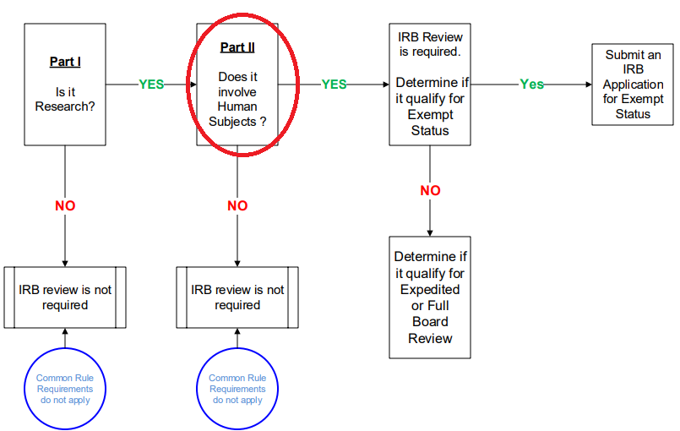
Definitions- Does the Research Involve Human Subjects?
Private Information: Includes information about behavior that occurs in a context in which an individual can reasonably expect that no observation or recording is taking place (e.g. medical visit), and information that has been provided for specific purposes by an individual and that the individual can reasonably expect will not be made public (e.g., a medical record).
Identifiable Private Information: Private information for which the identity of the living individual is or may readily be ascertained by the investigator or associated with the information.
Identifiable Biospecimen: A biospecimen for which the identity of the living individual from whom it is derived is or may readily be ascertained by the investigator or associated with the biospecimen
II-3-Does the research involve obtaining, using, studying, analyzing or generating private identifiable information or identifiable biospecimens about a living individual?
If yes, stop here because the project is research involving human subjects and an IRB application will be required.
If no, proceed to Part III.

Slide 15
When Does Research Involves HUMAN SUBJECTS?
If for the purpose of a research study an investigator:
Interacts with a living individual,
or
Ask them to take part in a intervention,
or
Manipulate their environment,
or
obtains, uses, studies, analyzes, or generates identifiable private information or identifiable bio-specimens about them.

Slide 16
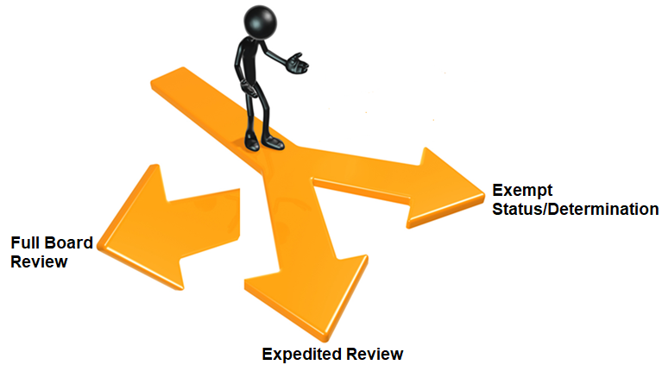
Human Subjects Research Determination
The third question will be to determine whether your study will require an IRB submission for Exempt Status, or Expedited review , or Full board review.
3. Does the human subject research qualify for an exemption or expedited review or full board review?

Slide 17
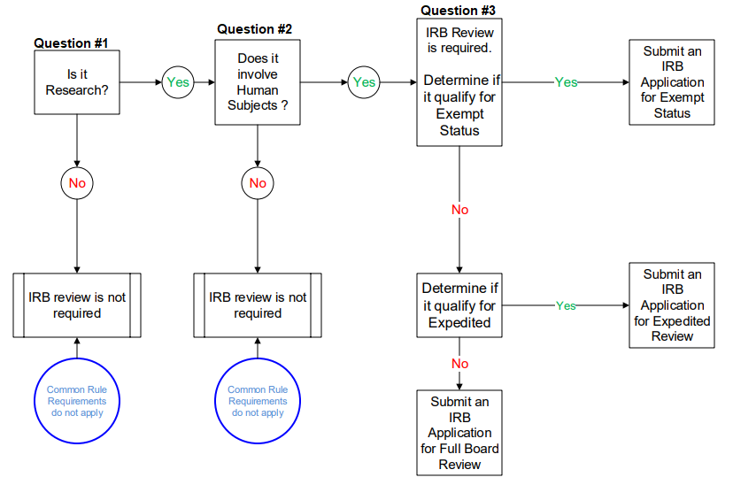
What does it means the study qualify for Exempt Status?
The study is human subjects (HS) research because it meets the conditions of one or more of the exempt categories described in the Request for Exemption Form .doc.
Investigators cannot make the determination as to whether a research project is exempt.
Investigators must obtain exempt status from the IRB prior to the start of the research.
The study is Exempt from regulatory oversight after the IRB has granted Exempt Status.
The study is not subject to continuing review requirements.
The closure or expiration of the study does not invalidate the exemption (e.g., the research may continue as planned).
Exempt
HS Research

Slide 18
What does it means the study qualify for Expedited review?
The study is non-exempt human subjects (HS) research
The study meets the conditions for one or more expedited categories described in the Request for Expedited Review Form.doc
The study may require continuing review or an annual check in update.
Exempt
HS Research
Non-Exempt HS Research

Slide 19
What does it means the study qualify for Full Board review?
The study is non-exempt human subjects (HS) research
The study does not fall within the categories for exempt or expedited review.
The study will require continuing review.
Non-Exempt HS Research

Slide 20
APPENDIX A - EXAMPLES OF HUMAN SUBJECT RESEARCH DETERMINATIONS
Per the revised version of 45 CFR 46 – Protection of Human Subjects, the following are not considered research per the regulation:
Scholarly and journalistic activities (e.g. oral history, journalism, biography, literary criticism, legal research, and historical scholarship), including the collection and use of information, that focus directly on the specific individuals about whom the information is collected.
Public health surveillance activities, including the collection and testing of information or biospecimens, conducted, supported, requested, ordered, required or authorized by a public health authority. Such activities are limited to those necessary to allow a public health authority to identify, monitor, assess, or investigate potential public health signals, onsets of disease outbreaks, or conditions of public health importance (including trends, signals, risk factors, patterns in diseases, or increases in injuries from using consumer products). Such activities include those associated with providing timely situational awareness and priority stetting during the course of an event or crisis that threatens public health (including natural or man-made disasters).
Collection and analysis of information, biospecimens, or records by or for a criminal justice agency for activities authorized by law or court order solely for criminal justice or criminal investigative purposes.
Authorized operational activities (as determined by each agency) in support of intelligence, homeland security, defense, or other national security missions.
Secondary research involving non-identified newborn screening blood spots is also not considered research.

Slide 21
What is Not Human Subjects Research
 | RESEARCH | HUMAN SUBJECTS
Case study / case series. | x | 
Survey Administration or Interview for a Non Research Purpose. | x | 
Secondary Analysis of de-identified data or de-identifiable specimens. |  | x
Research on cadavers or on samples obtained from cadavers. |  | x
Quality Improvement Project, in which there is no hypothesis or experimental question and the intention is to improve compliance with an existing and accepted policy not to contribute to generalizable knowledge | x | 
Case study / case series a write up of a single case, or two or three cases, does mot constituting research. The retrospective summary of such a few number of cases is not considered to meet the definition of research.
A review of four or more cases is considered to meet the definition of research and prospective IRB review is required.
Survey Administration or Interview for a Non Research Purpose There is no hypothesis or experimental question being asked so the definition of "systematic investigation" is not met, nor is there any intent to generalize the knowledge beyond the administration purposes
Secondary Analysis of De-Identified Data
When an investigator obtains a de-identified data set from another investigator, and/or from publicly available records, the data will contain specific data points that will be analyzed with specific statistical tests to answer a specific research question.
The activity may meet the definition of research, but because there is no intervention or interaction with a human and because the data is not private identifiable information, the definition of human subject is not met.

Slide 22
What is Not Human Subjects Research
 | RESEARCH | HUMAN SUBJECTS
Case study / case series. | x | 
Survey Administration or Interview for a Non Research Purpose. | x | 
Secondary Analysis of de-identified data or de-identifiable specimens. |  | x
Research on cadavers or on samples obtained from cadavers. |  | x
Quality Improvement Project, in which there is no hypothesis or experimental question and the intention is to improve compliance with an existing and accepted policy not to contribute to generalizable knowledge | x | 
Research on cadavers or on samples obtained from cadavers, IRB review is not needed as the definition of human subject pertains to living individuals. However, if personal identifying information is linked to the materials, then HIPAA must be appropriately addressed. The Assurance of Using Decedent Information form must be submitted to the IRB, which also acts as the HIPAA privacy board for research purpose
Quality Improvement Project there is no hypothesis or experimental question being asked so the definition of "systematic investigation" is not met and therefore the definition of research is not met; and the intention is to improve compliance with an existing and accepted policy not to contribute to generalizable knowledge.
Notes:
Case study / case series a write up of a single case, or two or three cases, does mot constituting research. The retrospective summary of such a few number of cases is not considered to meet the definition of research. A review of four or more cases is considered to meet the definition of research and prospective IRB review is required.
Survey Administration or Interview for a Non Research Purpose There is no hypothesis or experimental question being asked so the definition of "systematic investigation" is not met, nor is there any intent to generalize the knowledge beyond the administration purposes
Secondary Analysis of De-Identified Data
When an investigator obtains a de-identified data set from another investigator, and/or from publicly available records, thee data will contain specific data points that will be analyzed with specific statistical tests to answer a specific research question.
The activity may meet the definition of research, but because there is no intervention or interaction with a human and because the data is not private identifiable information, the definition of human subject is not met.
Research on cadavers or on samples obtained from cadavers, IRB review is not needed as the definition of human subject pertains to living individuals. However, if personal identifying information is linked to the materials, then HIPAA must be appropriately addressed. The Assurance of Using Decedent Information form must be submitted to the IRB, which also acts as the HIPAA privacy board for research purpose
Quality Improvement Project there is no hypothesis or experimental question being asked so the definition of "systematic investigation" is not met and therefore the definition of research is not met; and the intention is to improve compliance with an existing and accepted policy not to contribute to generalizable knowledge.

Slide 23
HIPAA Rule - Compliance

Slide 24
Part III - HIPAA Compliance
A- Determine whether the project falls within the definition of treatment, payment or health care operations?
B- Determine whether the project involves the use of Protected Health Information.

Slide 25
HIPAA Compliance
Part III, A- Does the project falls within the definition of treatment, payment or health care operations?
Payment: encompasses the various activities of health care providers to obtain payment or be reimbursed for their services and of a health plan to obtain premiums, to fulfill their coverage responsibilities and provide benefits under the plan, and to obtain or provide reimbursement for the provision of health care.
In addition to the general definition, the Privacy Rule provides examples of common payment activities which include, but are not limited to: determining eligibility or coverage under a plan and adjudicating claims; risk adjustments, billing and collection activities reviewing health care services for medical necessity, coverage, justification of charges, and the like; utilization review activities; and disclosures to consumer reporting agencies (limited to specified identifying information about the individual, his or her payment history, and identifying information about the covered entity).
Treatment: generally means the provision, coordination, or management of health care and related services among health care providers or by a health care provider with a third party, consultation between health care providers regarding a patient, or the referral of a patient from one health care provider to another.
Health Care Operations: are certain administrative, financial, legal, and quality improvement activities of a covered entity that are necessary to run its business and to support the core functions of treatment and payment. These activities, which are limited to the activities listed in the definition of “health care operations”

Slide 26
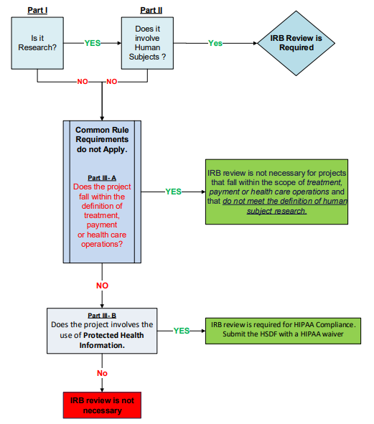
Part III-A
IRB review is not necessary for projects that fall within the scope of treatment, payment or health care operations.

Slide 27
HIPAA Compliance
Part III, B- Does the project involves the use of Protected Health Information?
Individually Identifiable Health Information
Information that is a subset of health information, including demographic information collected from an individual.
It is created or received by a heath care provider, health plan, employer or health care clearinghouse
Relates to the past, present or future physical or mental health or condition of an individual, the provision of health care to an individual, or the past present, or future payment of the provision of health care to an individual.
Identifies the individual or with respect to which there is a reasonable basis to believe the information can be used to identify the individual.

Slide 28
HIPAA Compliance, continuation
Part III, B- Does the project involves the use of Protected Health Information.
Protected Health Information (PHI) is
Individually identifiable health information, excluding individually identifiable health information in education records covered by the Family Educational Right and Privacy Act.
Under HIPAA protected health information is individually identifiable if it is associated to any of the following HIPAA defined identifiers in in the table below.
Names | Unique identify #s, characteristics or codes | Geographic Subdivisions
Phone | Serial #s | Health Plan Beneficiary
Fax | Account #s | Vehicle Identifiers
E-mail | Social Security #s | Biometric Identifiers
URL | License #s | Device Identifiers
IP Address | Medical Record #s | Dates (except year)
Notes:
n Table 1 below.
Note: HIPAA is only applicable when one or more of the following identifiers are associated with the heath information of an individual. Use of one or more identifier without any associated health information would not trigger HIPAA- in that case the answer to question III.2 below should be “NO.”

Slide 29
Part III- B - HIPAA Compliance
Does the project involves the use of Protected Health Information? ( e.g., one or more identifiers from the table below are associated with the individuals' health information)
place an X after the identifier(s) noted in Table 1 that will be associated to the health information,
submit the HSDF along with request of a HIPAA waiver to the IRB.
Yes
No
Names | Unique identify #s, characteristics or codes | Geographic Subdivisions
Phone | Serial #s | Health Plan Beneficiary
Fax | Account #s | Vehicle Identifiers
E-mail | Social Security #s | Biometric Identifiers
URL | License #s | Device Identifiers
IP Address | Medical Record #s | Dates (except year)
IRB review is not necessary, and PHI is not used in the project/activity.

Slide 30
Part III-B
IRB review is not necessary if the project does not involves protected health information (e.g., the health information is not associated to any of the HIPAA identifiers).

Slide 31
Human Subjects Research Determination
Part IV - Additional Details to Provide to The IRB

Slide 32
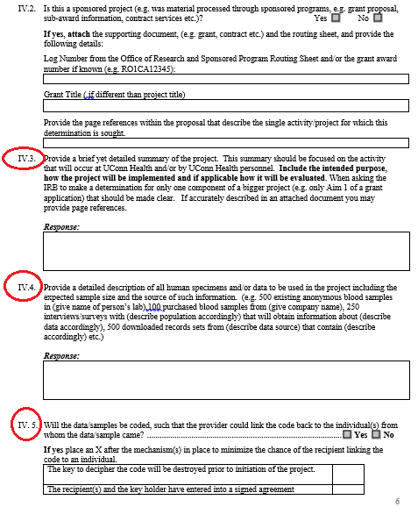
Human Subjects Research Determination
IV.3. In this section provide a brief yet detailed summary of the project.
This summary should be focused on the activity that will occur at UConn Health and/or by UConn Health personnel.
Include the intended purpose of the project , how the project will be implemented and if applicable how it will be evaluated.
IV.4. Provide a detailed description of all human specimens and/or data to be used in the project including the expected sample size and the source of such information. The IRB needs to know all the sources of the data and /or specimens you will obtain.

Slide 33
V - Resources
Human Subject Research Determination Form.doc
Frequently Asked Questions regarding Quality Improvement activities
2011-009.2.pdf – Institutional Review Board – Exemptions

